Slide 1

Azure Machine Learning Business Model Update
AML Business Planning, Engineering + Marketing
Serina, Sonal, Suds, Francisco

Slide 2
Why change the business model?
Our pricing at GA reflected our product’s relative immaturity and code-only ML offering, but that has changed
We now offer high value no-code ML and ML Ops capabilities
Azure ML has seen steady growth in usage and customers but not in revenue
Over >27% growth in external core hours Feb ~ June
16% in ‘high value’ customers, i.e. those using more than 2K core-hrs
Existing model does not fully monetize value added features
No IP-revenue from training activities
Limited pricing for AKS/inferencing

Slide 3
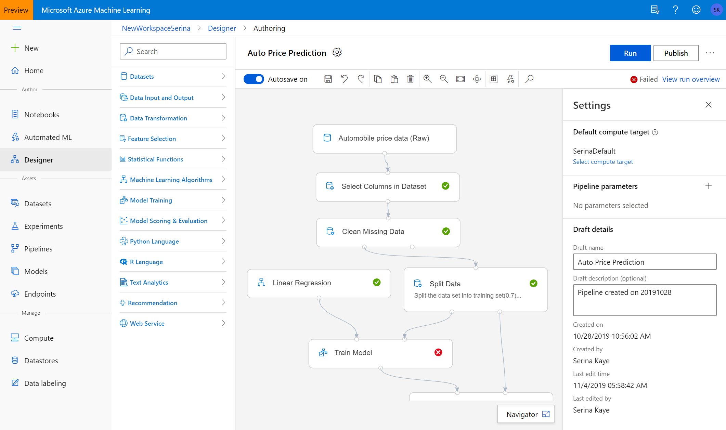
Announcing Azure Machine Learning Enterprise Edition
What are we announcing? At Ignite, we announced the new Azure Machine Learning Enterprise and Basic editions. The Enterprise edition contains our no-code ML capabilities (AutoML and designer) as well as cutting edge AutoML features such as DNNs, enterprise grade ML Ops capabilities such as data drift monitoring, and cross-workspace compute management.
The Enterprise edition is in preview at this time. While in preview, customers with Enterprise workspaces will pay only for Azure resources consumed.
All capabilities of AzureML that were in general availability before Ignite are now available in the “Basic” edition, now in GA. Basic workspaces will incur costs only for consumed Azure resources.

Slide 4
Enterprise and Basic: Summary
Azure Machine Learning offers two editions: Enterprise and Basic
Basic edition is available in general availability
Enterprise edition currently in preview
More detail on our pricing page: https://azure.microsoft.com/en-us/pricing/details/machine-learning/
 | Basic | Enterprise
Pricing structure | Pay only for Azure resources consumed No charge for AzureML | No up-front cost – scale as you need, pay for what you consume Compute surcharge for ML activities: data prep, training, inferencing
Audience | Experienced data scientists who like a code-first environment Single data scientists or small data science teams who don’t need enterprise price controls, or large-scale ML Ops | Large enterprises with mixed data science, data engineering and analyst teams who would benefit from both code-forward and drag-and-drop ML Large data science teams that need to share compute across workspaces, or access other enterprise features
Messages | The best place for open source ML Use your existing tools and IDE when scaling to the cloud Best in class code-first experience | Basic level + Best in class ML for all skill levels including no-code ML Enterprise-grade security, governance and cost control Comprehensive ML lifecycle management
[Roadmap features] | Responsible AI toolkit Reinforcement learning Batch inferencing Manual data labelling | Data drift capabilities Automated ML ensemble models and deep learning Automated model retraining Managed inferencing ML assisted labelling
Notes:
Next steps:
Bharat to review w/ JG (add naming slides)
Suds to set up review w/ Richard
Friday LT review – dev plan to land this

Slide 5
Pricing
 | Price per core hour
Machine Learning Compute
Basic Edition | $0.00
Enterprise Edition
core-hr CPU | $0.07
core-hr GPU NC-series | $0.15
core-hr GPU NC2-series | $0.35
core-hr GPU NC3-series | $0.51
Machine Learning Inferencing
Basic Edition | $0.00
Enterprise Edition
core-hr CPU | $0.07
core-hr GPU NC-series | $0.15
core-hr GPU NC2-series | $0.35
core-hr GPU NC3-series | $0.51
How much does the new Enterprise edition cost? Enterprise workspaces will incur a surcharge on compute consumed during training and inferencing. The Enterprise edition will be free while in preview. GA is currently scheduled for early Q1 of calendar year 2020.
Are there any other pricing changes? Azure Machine Learning Basic workspaces will no longer have to pay a surcharge on Azure Kubernetes deployments. The AKS surcharge of 4c per core hour will be dropped.
View our pricing page for a detailed feature map
https://azure.microsoft.com/en-us/pricing/details/machine-learning/

Slide 6
Appendix

Slide 7
Competitive Landscape: Capabilities
 |  | Azure | GCP | AWS
Productive | ML for any skill (experience spanning visual and code) |  | ✕ | ✕
 | Automated/Augmented machine learning experience |  |  | ✕
 | Reinforcement learning | ✕ | ✕ | 
Enterprise Ready | MLOps with integrated CI/CD |  | ✕ | ✕
 | Reusable multi-step pipelines |  |  | ✕
 | A/B Testing and model performance monitoring | ✕ |  | 
 | Enterprise-scale collaboration | ✕ |  | 
Trusted | Centralized model registry for tracking and version control |  |  | ✕
 | Model interpretability |  | ✕ | 

Slide 8
Competitive Landscape: Business Models
 |  | Amazon | Google | Databricks
Product |  | SageMaker | Cloud ML AutoML | Azure Databricks Data Analytics / Engineering
Personas |  | Data Scientists DevOps | Data Scientists DevOps App Developers Custom Models | Data Scientists
SKU |  | Single SKU | Single SKU per service feature | Standard + Premium
Business Model |  | VM + IP | VM + IP API Based | VM + IP (DBU)
ML Infra H/W |  | Amazon Elastic Inference | Cloud TPU | FPGA Series
IP Price |  | 40% pegged VM | 46% pegged to VM | Up to 150% relative to VM

